Slide 1
Microsoft Power Automate Empowerment
Notes:
Hi, Welcome to Microsoft Power Platform + Dynamics 365 Bootcamp.

Slide 2
Course Overview
Day 1
Empowering everyone with Power Platform
Day 2
Power Automate Introduction
Day 3
Power Automate Project Scenarios
Day 4
Monitoring & Administration of Power Automate
Introduction to Power Platform
Microsoft Power Platform momentum
Why Power Platform?
Customer Stories
Power Platform Components Demo
Power Platform Account Setup
Microsoft Flow Basics
Microsoft Flow Templates
Decision Making with Flow
Conditions, Switches, Scope & Context of Decision-Making Control Elements
Building Workflows with Power Automate
Hands on Lab - Microsoft Flow
Approve / Reject Workflow Scenario
User Input Acceptance & Validation Workflow Scenario
Recurrance Workflow Scenario
Dynamic 365 Integration Workflow Scenario
Azure Cognitive Services AI Integration Workflow Scenario
Power App Integration Workflow Scenario
SQL Server Integration Workflow Scenario
HoL - End to End Business Flow with all Scenarios
Import, Export Flows
Distribute Flows
Sharing of Flows across workspaces
Different Flow Environments and Code Promotion
Data Policies & Integration Check Points
Flow History and Analytics
HoL - Check your Knowledge

Slide 3
Day2:Power Automate Introduction

Slide 4

Agenda
Microsoft Flow Basics
Microsoft Flow Templates
Decision Making with Flow
Conditions, Switches, Scope & Context of Decision-Making Control Elements
Building Workflows with Power Automate
Hands on Lab - Microsoft Flow

Slide 5
Microsoft Power Platform momentum
>3M
Monthly active developers on the Power Platform
>700%
Power Apps growth in production apps in the last year
>300%
Power Apps growth in monthly active users in the last year
>25M
Data models hosted in the Power BI service
97%
of Fortune 500 companies using Power BI
>25B ​
Power Automate steps run each day​

Slide 6

Our mission…
Not only are we empowering a community of makers to achieve more..
1.4M
91K
100K
Active community members
User group members
In-person conference attendees
389K
409
26K
Users submitting ideas
Independent user groups
App/Dashboard in a Day attendees

Slide 7

Our mission… includes governance!
Not only are we empowering a community of makers to achieve more..
1.4M
91K
100K
Active community members
User group members
In-person conference attendees
389K
409
26K
Users submitting ideas
Independent user groups
App/Dashboard in a Day attendees
But were are also committed to empowering admins with full visibility and the tools they need to balance business productivity with governance

Slide 8



Microsoft Power Platform
The low-code platform that spans Office 365, Azure, Dynamics 365, and standalone applications
Innovation anywhere. Unlocks value everywhere.
Power BI
Business analytics
Power Apps
Application development
Power Automate
Process automation
Power Virtual Agents
Intelligent virtual agents
Data connectors
Portals
AI Builder
Common Data Service

Slide 9
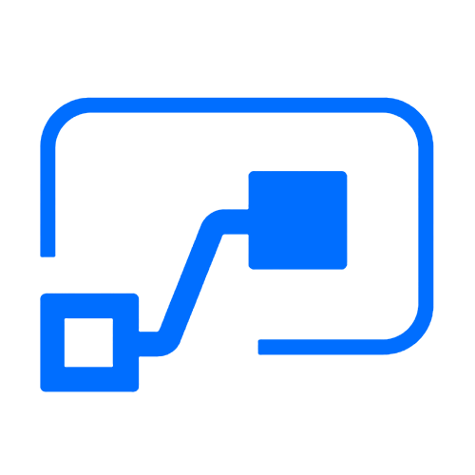

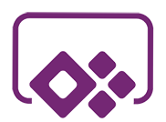

Who here has a Microsoft 365 background?
SharePoint, Teams, Exchange…
Microsoft 365
Analyze
Act
Automate
Data connectors
Power BI
Business analytics
Power Apps
Low-code/no-code application development
Power Automate
Workflow automation
Standalone apps
Common Data
Service
AI Builder

Slide 10
What about a Dynamics 365 background?
Sales, Service, Talent…
Microsoft 365
Dynamics 365
Analyze
Act
Automate
Data connectors
Power BI
Business analytics
Power Apps
Low-code/no-code application development
Power Automate
Workflow automation
Standalone apps
Common Data
Service
AI Builder

Slide 11
Last, but not least, what about Azure?
Azure SQL, Azure Functions…
Microsoft 365
Dynamics 365
Microsoft Azure
Analyze
Act
Automate
Data connectors
Power BI
Business analytics
Power Apps
Low-code/no-code application development
Power Automate
Workflow automation
Standalone apps
Common Data
Service
AI Builder

Slide 12
Why Power Platform?
Time
Resources
Cost
Data
Maintenance

Slide 13

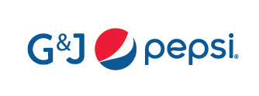
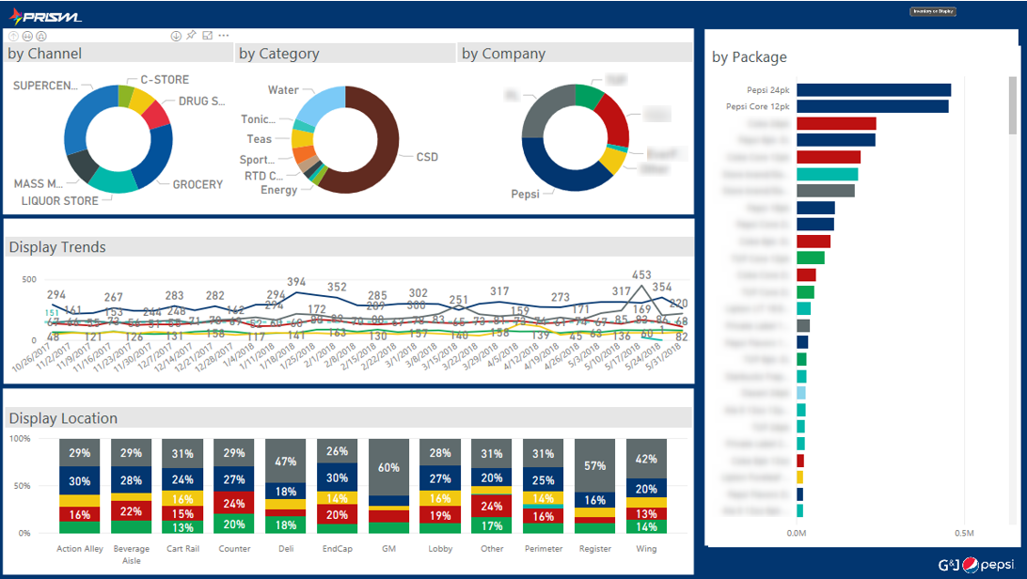
Building apps that save money
A small team at G&J Pepsi with no previous app-development experience created auditing apps that saved the company $500,000
https://customers.microsoft.com/en-us/story/gj-pepsi-consumer-goods-powerapps

Slide 14


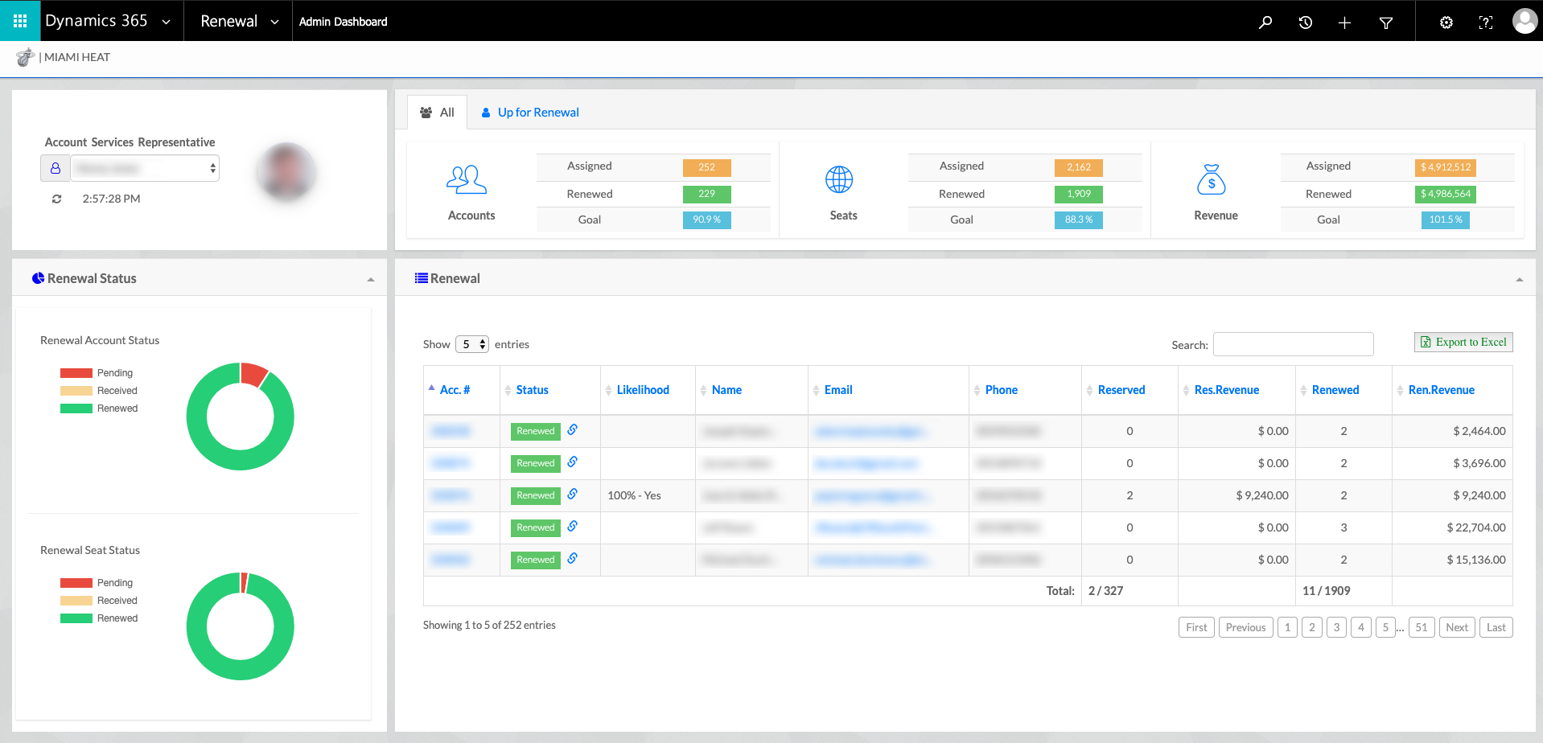
Customer: Miami HEAT
Industry: Media and Entertainment
Size: 50–999 employees
Country: United States
Products and services: Microsoft Dynamics 365 Sales
Microsoft Power BI
Microsoft Azure
Read full story here
“After we implemented the data warehouse and Dynamics 365, we had a 30 percent year-over-year increase in our season ticket sales with essentially the same team on the floor.”
—Matthew Jafarian, Executive Vice President of Business Strategy, Miami HEAT
The Miami HEAT is always trying to make fan experiences even better. In the past, inefficient data collection and analysis sometimes delayed decision-making and made it hard to understand fan needs and expectations.
The HEAT adopted Microsoft Dynamics 365, Power BI, and Azure. The HEAT now aggregates 360-degree fan profiles to personalize fan communications, and it uses Adobe Marketing Cloud to harness the profiles to personalize digital experiences.
With better views into its data, the HEAT streamlined fan experiences networking. With Power BI insights, the organization saved approximately $1 million with simple operational changes, and 360-degree profiles in Dynamics 365 have helped drive a 30 percent increase in season ticket sales.

Slide 15


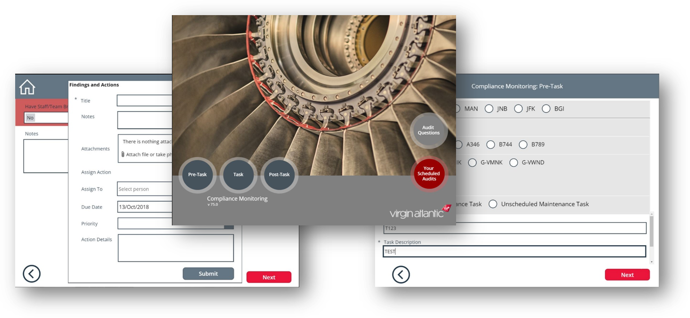
Boosting customer satisfaction
Virgin Atlantic creates custom-built mobile apps to continually improve the start-to-finish travel experiences of 5 million passengers a year.
https://customers.microsoft.com/en-US/story/virgin-atlantic-travel-and-transportation-power-apps

Slide 16




Vehicle glass repair provider digitizes processes and increases productivity with self-developed apps
Harmony to update image and add published link
Belron® is the worldwide leader in vehicle glass repair and replacement through brands such as Autoglass®, Carglass®, and Safelite®. To streamline previously manual and time-consuming processes, the company adopted Microsoft PowerApps, part of the full Microsoft Business Application Platform stack. It now uses more than 40 apps, all developed in-house by just one employee with no programming skills. Used broadly across the business, from HR to field service reps, the apps help the company improve efficiency, save money, and make it easier for staff to operate effectively.
Microsoft PowerApps
Microsoft Flow
Microsoft Power BI
Common Data Service for Apps
Microsoft Office 365
26,300 employees
Consumer Goods
United Kingdom
Notes:
https://customers.microsoft.com/en-us/story/belron-autoglass-consumer-goods-powerapps

Slide 17
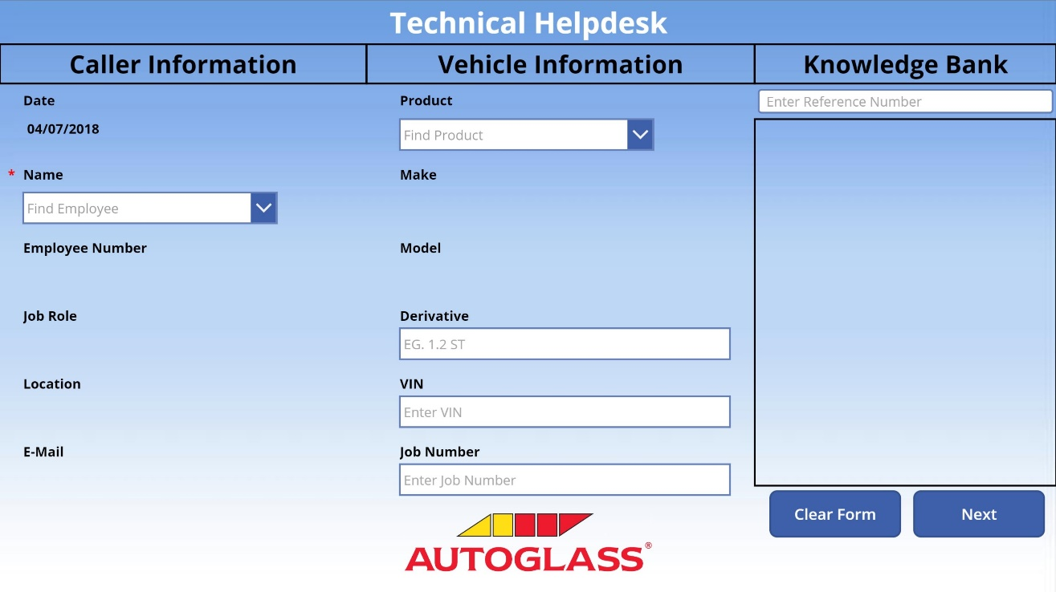
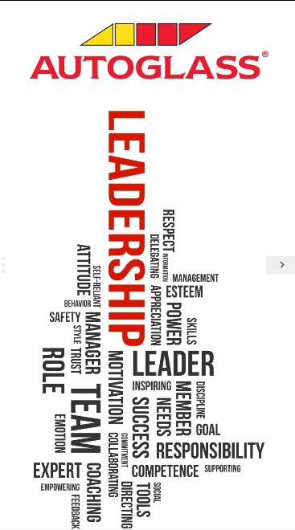
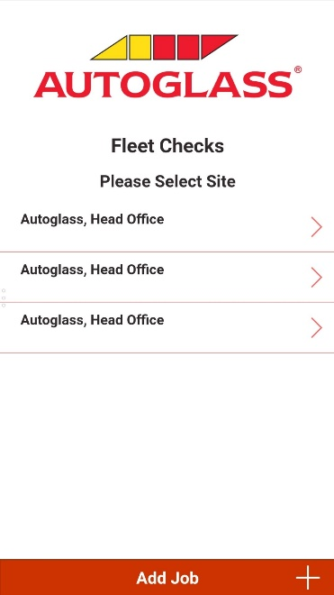
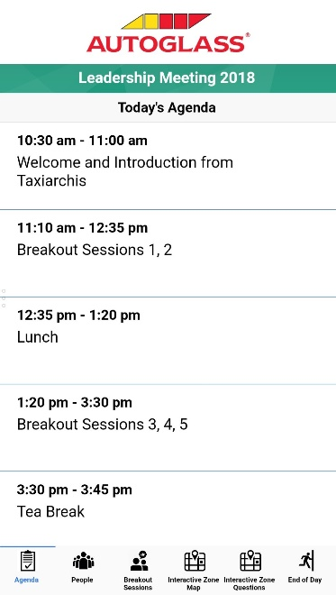
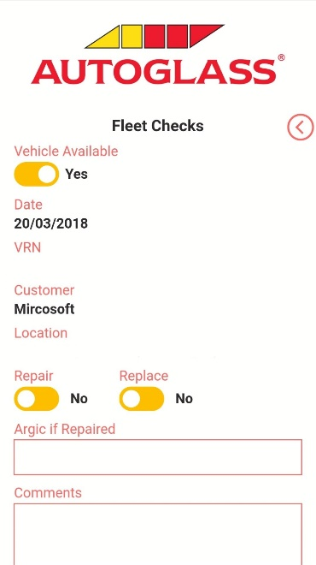
Technical Helpdesk App
Leadership App
Fleet Checks App
PowerApps
Microsoft Flow
Microsoft Power BI
Common Data Service
Microsoft Office 365
26,300 global employees
Consumer Goods
United Kingdom
N/A
Achieve more together
Anywhere it matters
Simplified for business
Notes:
https://customers.microsoft.com/en-us/story/belron-autoglass-consumer-goods-powerapps

Slide 18


Customer: French National Railway Company (SNCF)
Industry: Travel and Transportation
Size: 270,000 employees
Country: France
Products and services: Microsoft Flow Microsoft PowerApps Microsoft Power BI Microsoft SharePoint Online
Read full story here
“When we implemented and explained the potential of these digital tools, we empowered each employee to innovate and share their ideas on how to improve their work on a daily basis.”
—Magali Dupin, Continuous Improvement and Communication Manager, SNCF
As part of ongoing efforts to improve business productivity, French national railway company SNCF launched an initiative called “Digital for All” to better include employees in digital solution development.
SNCF adopted Microsoft PowerApps, Power BI, and Microsoft Flow, then used internal and online training to foster employee adoption, cultivate internal app experts, and create new, innovative apps that digitize business and maintenance processes.
Tens of thousands of SNCF employees now use more than 150 apps to help simplify and streamline tasks. And the company uses real-time analysis in Power BI to reduce errors, increase reliability, and improve production processes.

Slide 19
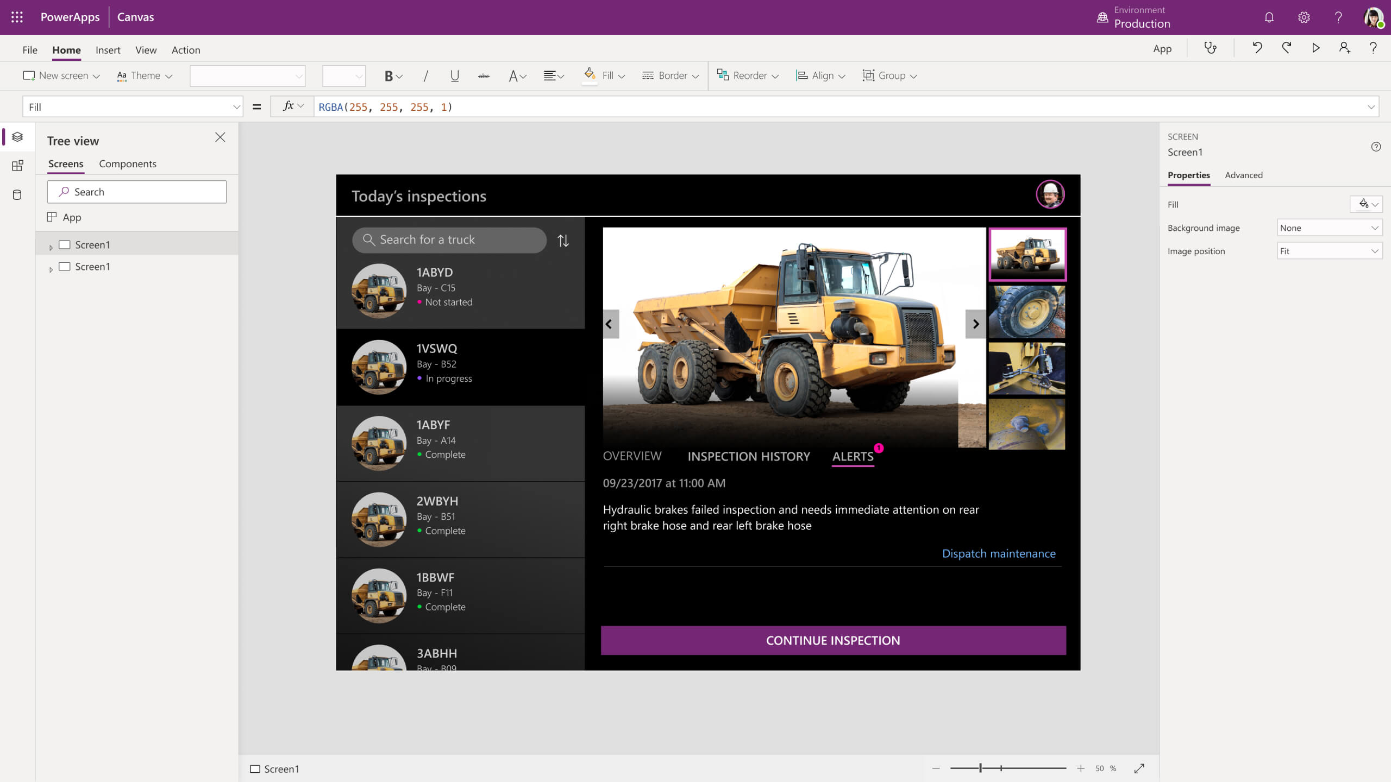
Power Apps
Turn ideas into organizational solutions by enabling everyone to build custom apps that solve business challenges.

Slide 20
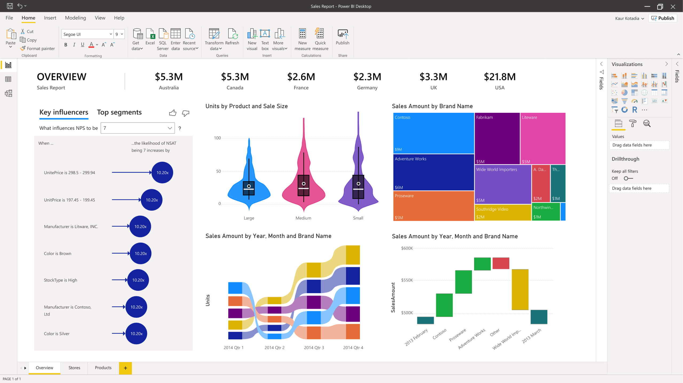
Power BI
Make informed, confident business decisions by putting data-driven insights into everyone’s hands.

Slide 21
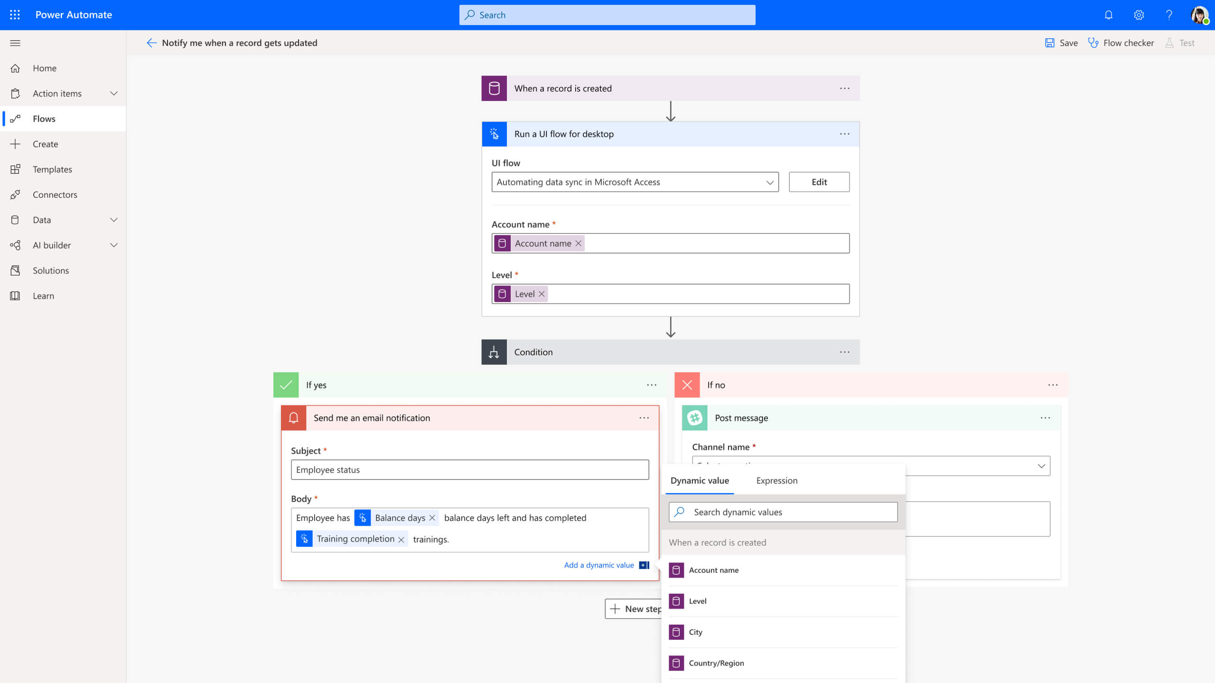
Power Automate
Boost business productivity to get more done by giving everyone the ability to automate organisational processes.

Slide 22
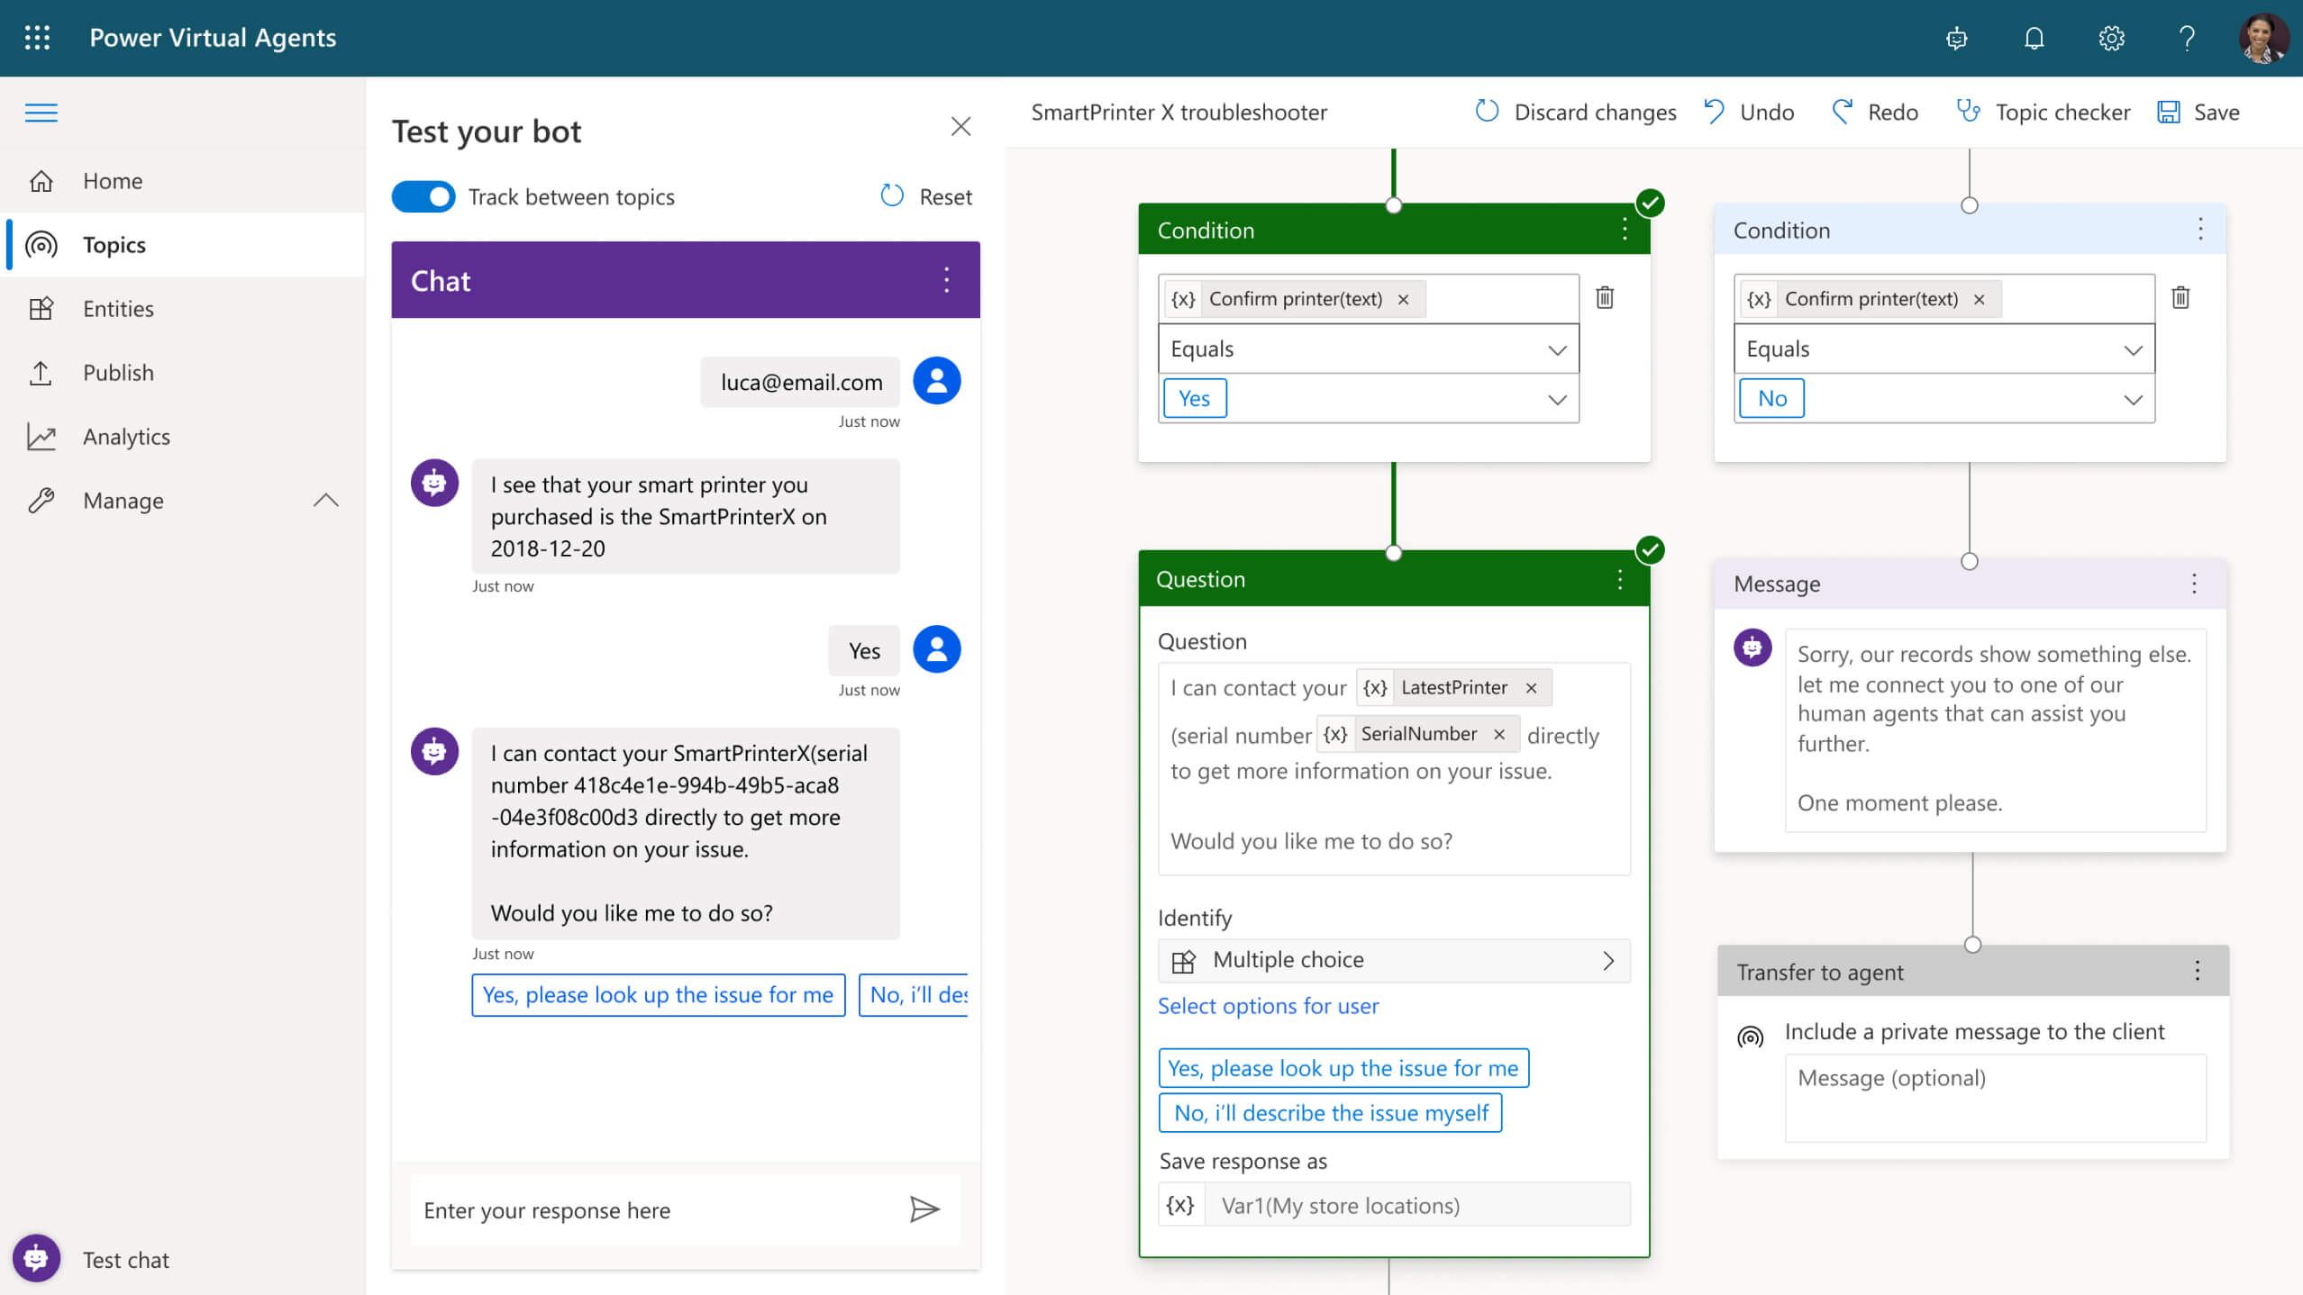
Power Virtual Agents
Easily build chatbots to engage conversationally with your customers and employees—no coding required.

Slide 23
PowerApps
Power BI
Microsoft Flow
Dynamics 365
Microsoft
Power Platform
Azure
Office 365
Standalone Apps
Common Data Service for Apps
Data Connectors

Slide 24

The Microsoft Cloud
Microsoft Dynamics 365
Microsoft 365
Microsoft Power Platform
Microsoft Azure
Notes:
The Microsoft Cloud
The Microsoft Cloud delivers an open, flexible, enterprise-grade cloud computing platform for IaaS, SaaS, and PaaS.
Infrastructure as a service (IaaS) = Microsoft Azure
Platform as a service (PaaS) = Microsoft Azure
Software as a service (SaaS) = Microsoft 365 (Office 365)
T: The Cloud is crucial when it comes to your data.
<click>

Slide 25
Notes:
Data is simply everywhere.
Your singular business creates petabytes of data – spanning customer interactions, internal communications, orders, vendor transactions – and that’s not even considering the connections that that data has with external market data and customer information.
T: Data is prolific. The real opportunity is in how you capture and harness it.
<click>

Slide 26

Customers
Products
Operations
People
Notes:
Technology and process have traditionally supported data living in its own silo – supporting a specific business unit or project – opportunities and issues not realized.
Even with the hyperscale cloud capabilities of Azure, we still saw data siloed in its source system.
T: The number of positive outcomes and actionable insights is exponential when you can bring this data together.
<click>

Slide 27

Transform
products
Optimize
operations
Data & AI
Engage
customers
Empower
people
Notes:
The Common Data Service allows you to connect data that’s been captured via the numerous channels and interfaces that support your business, allowing you to identify the interdependencies between the people that run every facet of your business, the products, the operational efficiencies, and your customers.
We call this a digital feedback loop – and it can only be realized by breaking down your organizational data siloes, and bringing your data into one unified source, allowing you to apply reason – and get the full picture of your organization's strengths and opportunities.
Then and only then, are you able to learn from each action. With this foundation, you can then apply Intelligence and leverage Artificial Intelligence that can uncover relevant learnings and automate to take the next best action.
T: It’s about creating a technology stack that supports the interconnected nature of each business…
<click>

Slide 28


Dynamics 365
The world’s connected AI business cloud
Sales
Talent
Marketing
Finance
Service
Supply Chain
Commerce
Project Service Automation
Power Platform
Notes:
Dynamics 365: The world’s connected AI business cloud
…and activating modular apps that can flex to meet specific core business needs.
Capturing the connections and interactions occurring in your business on a daily basis – across your people, products, operations, customers.
T: Having a common data strategy leveraging the Common Data Service enables true benefits by aligning your business workflows and supporting extension with Power Platform.
<click>

Slide 29
Microsoft Dynamics 365 & Power Platform
Intelligent Sales & Marketing
Proactive Customer Service
Connected Field Service
Modern Finance & Operations
Connected Commerce
Power Platform
Dynamics 365 Sales | Dynamics 365 Customer Service | Dynamics 365 Field Service | Dynamics 365 Finance | Dynamics 365 Commerce | Power BI
Dynamics 365 Marketing | Dynamics 365 Field Service | Dynamics 365 Marketing | Dynamics 365 Supply Chain Management | Dynamics 365 Marketing | PowerApps
 | Dynamics 365 Marketing | Dynamics 365 Customer Service | Dynamics 365 Business Central |  | Flow
 |  |  | Dynamics 365 Talent |  | AI Builder
Dynamics 365 Customer Insights | Dynamics 365 Customer Insights | Dynamics 365 Customer Insights | Dynamics 365 Fraud Protection | Dynamics 365 Connected Store | Portals
Dynamics 365 Sales Insights | Dynamics 365 Customer Service Insights | Forms Pro |  | Dynamics 365 Fraud Protection
Dynamics 365 Market Insights | Dynamics 365 Virtual Agent for Customer Service |  |  | Dynamics 365 Customer Insights
LinkedIn Sales Navigator | Dynamics 365 Product Insights
Forms Pro | Forms Pro
Dynamics 365 Product Visualize | Dynamics 365 Guides | Dynamics 365 Remote Assist | Dynamics 365 Guides
 |  | Dynamics 365 Guides | Dynamics 365 Layout | Dynamics 365 Layout
Transactional
Notes:
Microsoft Dynamics 365 & Power Platform
Dynamics 365 brings your connected data to life, enabling productivity throughout your organizations – Sales & Marketing, Customer & Field Service, Finance and Operations, and Commerce.
<click>
Tried and true, transactional data provides a goldmine of information.
Now not only the data points that occur within one organization can be captured, but the intricacies of handoff and engagement across all departments provide a 360-view of how your business functions. Automation and workflows can now be enabled that create consistent and connected interactions.
T: Expanding the impact of your transactional data…
<click>

Slide 30

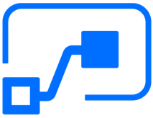

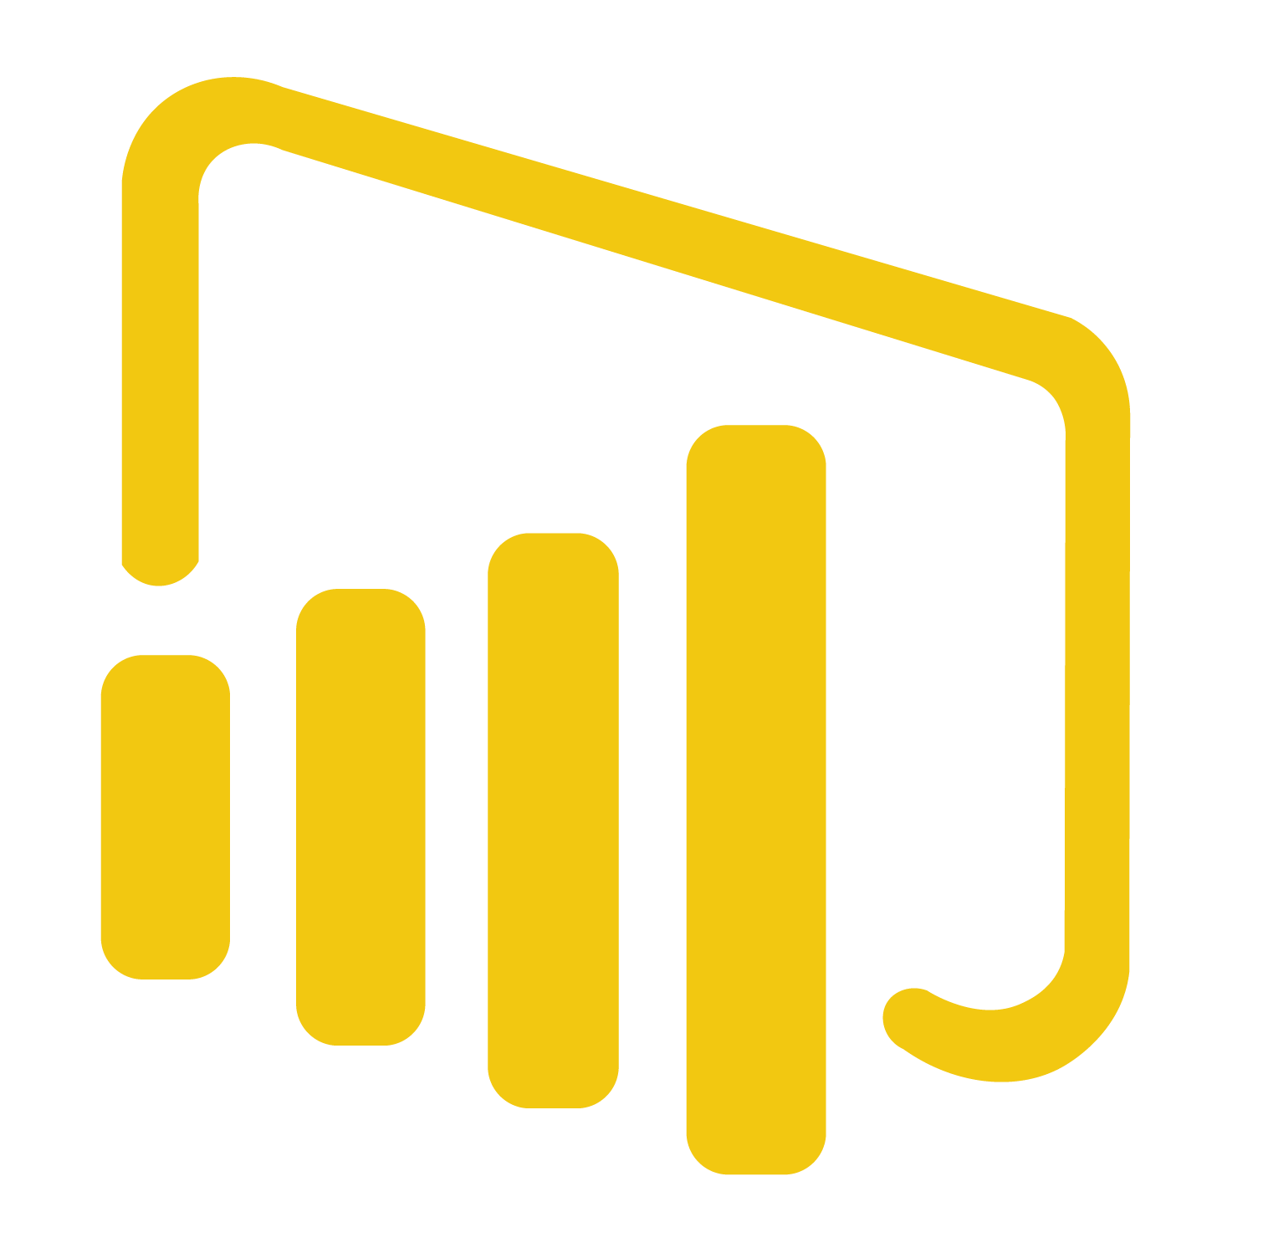
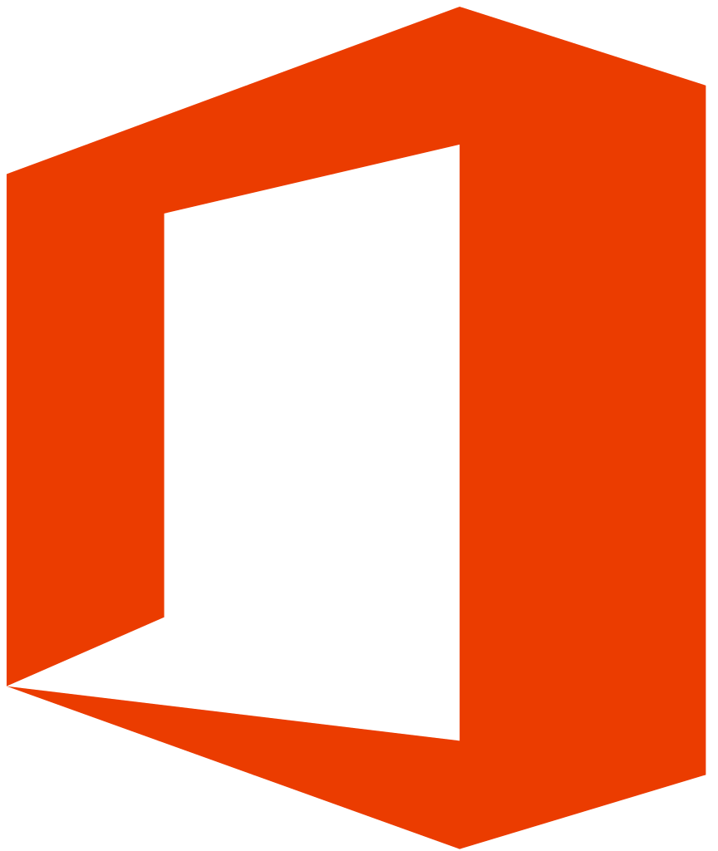

The Common Data Model and Common Data Service
PowerApps, Automate, Power BI, Virtual Agents
Dynamics 365 CE
Dynamics 365
F&O
Power BI
Office
Azure Data Services
AS/BI Semantic Models
Substrate
AI + ML
Common Data Service
Dual write
F&O data
Connectors
Dataflows
Connectors
Office data
Azure Data Lake
Enrichment & AI
Dataflows
Common Data Model
Data Integration
Read more here
Notes:
The Common Data Model and Common Data Service
This is how CDM and CDS work together with your apps and Azure Data Lake.
For finance we have dual writes into the CDM so it can sit in your Azure Data Lake. We gain value from modeling it and having the same schema. As previously mentioned, you can leverage our APIs to extend your custom and third-party apps. We’re also working directly with third parties for our ODI initiative to enable this extension from your APIs into ours.
Once you have this, you can leverage Power Platform and PowerApps to execute new automation across your applications.
You can customize and build your own interfaces and reports using the capability we’ve opened up through Power Platform.
<click>
<Transition to Radhika>

Slide 31

Global reach of Microsoft Cloud infrastructure
14
Dynamics and Power Platform geos
North America
Europe
Asia Pacific
Canada
South America
UK
France
India
Japan
Australia
UAE
South Africa
Norway
Switzerland
US Government
Germany
China
Legend:
= Available
= Announced
Notes:
Global reach of Microsoft Cloud infrastructure
Infrastructure strategy is influenced by:
Business demand
Competition
Compliance
Data residency
Local regulations
Security & Technology
Local, sovereign, and global datacenter infrastructure stimulates economic development for both customers and partners alike, enabling companies, governments and regulated industries to realize the benefits of the cloud for innovation, as well as bolstering the technology ecosystem that supports the innovation.
To help meet the needs of customers with unique regulatory or compliance requirements as well as expand our global footprint, we continually launch our cloud services in new infrastructure regions.
Azure services, which are foundational, is made available first new geo, followed by other Microsoft services -- Dynamics 365, Power Platform & Office 365 services.
<click>

Slide 32
A range of cloud offerings
Global cloud unlocks digital transformation around the world
North America
Europe
Asia Pacific
Canada
South America
UK
France
India
Japan
Australia
UAE
South Africa
Norway
Switzerland
US Government
Germany
China
Go Local cloud supports country and region-specific requirements
Sovereign cloud ensures compliance with key restrictions
Legend:
= Available
= Announced
Notes:
A range of cloud offerings
Global cloud: Hyperscale globally connected cloud services. Includes multiple geos addressing specific data residency and compliance requirements
Go Local cloud:
US/EMEA/APAC - A set of datacenters within a country border deployed within a latency defined boundary for synchronous replication if customer data in support of disaster recovery e.g. France / India
Sovereign cloud: Hyperscale cloud services, isolated from global could services. Deployed from a local datacenter to meet unique requirements of a specific market e. China / US Gov
<click>
Photo source: https://www.istockphoto.com/photo/aerial-view-of-hong-kong-gm900611166-248476439

Slide 33



Why move to Microsoft cloud
One version
Always up to date on the latest version
TCO of SaaS vs. On-premise
OPEX vs. CAPEX, free sandbox environments, backups & data recovery included, etc.
Security and compliance
Highly secure by design and compliance leadership with standards and contractual commitments
Notes:
Why move to Microsoft cloud
One version: In July 2018 we announced a change to the way we deliver Dynamics 365 updates that will help you stay current in a consistent, predictable, and seamless manner.
TCO of SaaS vs. On-premise: If you are a Microsoft Dynamics on-premises customer, then you’re cloud ready. Access cutting-edge technology, control costs and complexity, and improve IT productivity by migrating your existing solution to the cloud. This is the cost of your software application including the cost of all supporting products and services, such as ISV solutions, add-on applications, customizations and other integrations to ensure your ERP system is fully inter-operable with existing systems. One big difference from a licensing standpoint is that the cloud is a SaaS that you pay-as-you-go monthly or annually and expense the cost, which is classified as Operating Expense (OpEx). In the case of on-premises applications, you pay a high upfront cost classified as a Capital Expense (CapEx) which is usually depreciated or amortized over several years.
Security and compliance: Get peace of mind knowing your sensitive business data is stored in highly-secure, state-of-the-art data centers owned and managed by Microsoft. Your data will be there when you need it, thanks to a 99.9 percent uptime service-level agreement (SLA).
<click>

Slide 34
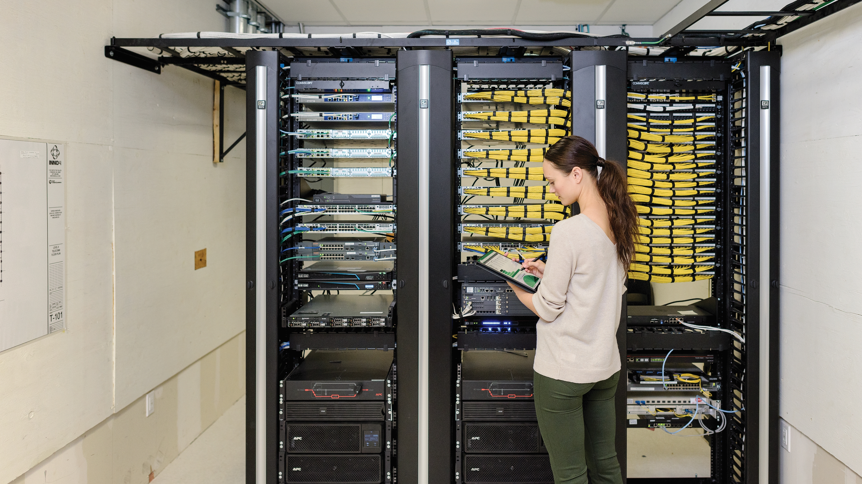
Trust
We have a set of foundational principles that guide the way we do business in the cloud
Security
Privacy & Control
Transparency
Compliance
Leading technology and processes
Content encryption
Permissions
Access and mobility options
Usage, management, and protection
Law enforcement requests
Laws, regulations, and key international standards
Microsoft service certifications
Notes:
Trust principles
(This slide is a build)
We have a set of foundational principles that guide the way we do business in the cloud.
<click>
Security:
Your content should be safeguarded from hackers using state-of-the-industry security technology and processes.
Your content should be encrypted in transit and at rest.
<click>
Privacy & control:
Your content should only be used as permitted by you and should not be shared with third parties unless permitted by you.
You should always have access to your content and should be able to delete it or take it with you if you leave.
<click>
Transparency:
You should have a clear, plain-language explanation of how your cloud provider uses, manages and protects your content.
You should be told how your cloud provider will respond to law enforcement requests to access your content.
<click>
Compliance:
Your content should be stored and managed in compliance with applicable laws, regulations and key international standards.
You should have the ability to see the certifications for each Microsoft service.
<click>

Slide 35

Create work order
Re-route to new queue
Incident types
Customer connects
Portal/Website
Chat
Email
Phone
SMS
Device monitoring
Social
Agent engagement
Bot/Virtual Agent
Human Agent
Bot to Human Agent transfer
Consult
Supervisor assist
Topic trend management
Schedule and dispatch
Geo-spatial availability
Automation
Remote commands
Close the case
Routing
Queue Management
Customer Profile
Research
Knowledge Base
Product/Warranty
Troubleshooting
SLAs
Field engineer
Mobile interface
Work order details
Dynamics 365
Customer Service and
Dynamics 365 Field Service
Next Best Action
Step-by-step instructions
Remote commands
Expert Assistance
Remote support
Visual guidance
Positive outcome
Data capture
CDS
CDM
Actionable insights
Close the work order
Mobile documentation
Image capture
Payment
Supervisor
Topic, sentiment, & agent telemetry
Training opportunities
Survey distribution
Automated, personalized per case
Channel-agnostic
Sentiment analysis
Negative outcome
Notes:
Dynamics 365 Customer Service and Dynamics 365 Field Service
Dynamics 365 Customer Service and Dynamics 365 Field Service are built on the same platform, making integration easy for users to support a dynamic and connected service org.
Functionally, this is what customer service and field service look like.
T: In order to support these functions, service organizations need specific tools along the way.
<click>

Slide 36

Demo
Create a canvas app from scratch based on Excel data

Slide 37
Customer Stories
Questions

Slide 39
Day 3 - Power Automate Project Scenarios

Slide 40






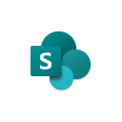
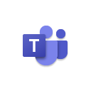




Jenkins NS
Modern Workplace Solution Architect | Consultant
Microsoft Teams, Power Platform and SPFx Specialist
International Speaker | Blogger | Trainer
SPS Bangalore Organizer
aOS Ambassador
jenkinsns@gmail.com
in/jenkinsns
@jenkinsns
http://www.jenkinsblogs.com
jenkinsns
https://www.facebook.com/spfxinfo/
https://www.facebook.com/msteamsinfo

